Slide 1
Cloud Computing Intro

Slide 2
Intro to Cloud Computing: Agenda
Intro to Cloud Computing: Agenda
Computing at scale
  The need for scalability; scale of current services
  Scaling up: From PCs to data centers
  Problems with 'classical' scaling techniques
Utility computing and cloud computing
  What are utility computing and cloud computing?
  What kinds of clouds exist today?
  What kinds of applications run on the cloud?
  Virtualization: How clouds work 'under the hood'
  Some cloud computing challenges

Slide 3
How many users and objects?
How many users and objects?
Flickr has 10 billion photos
Facebook has 1.4 billion daily active users
Google is serving 3.5 billion queries/day on over 130 trillion pages
5 billion videos/day watched on YouTube

Slide 4
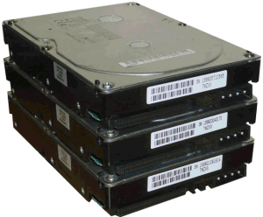
How much data?
How much data?
Modern applications use massive data:
  Rendering 'Avatar' movie required >1 petabyte of storage
  eBay has >6.5 petabytes of user data
  CERN's LHC will produce about 15 petabytes of data per year
  In 2008, Google processed 20 petabytes per day
  German Climate computing center dimensioned for 60 petabytes of climate data
  Google now designing for 1 exabyte of storage
  NSA Utah Data Center is said to have 5 zettabyte
How much is a zettabyte?
  1,000,000,000,000,000,000,000 bytes
  A stack of 1TB hard disks that is 25,400 km high
25,400 km

Slide 5
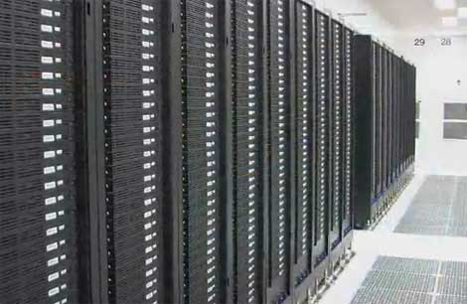
How much computation?
No single computer can process that much data
  Need many computers!
How many computers do modern services need?
  Facebook is thought to have more than 60,000 servers
  1&1 Internet has over 70,000 servers
  Akamai has 95,000 servers in 71 countries
  Intel has ~100,000 servers in 97 data centers
  Microsoft reportedly had at least 200,000 servers in 2008
  Google is thought to have more than 1 million servers, is planning for 10 million

Slide 6
Why should I care?
Why should I care?
Suppose you want to build the next Google
How do you...
  ... download and store billions of web pages and images?
  ... quickly find the pages that contain a given set of terms?
  ... find the pages that are most relevant to a given search?
  ... answer 1.2 billion queries of this type every day?
Suppose you want to build the next Facebook
How do you...
  ... store the profiles of over 500 million users?
  ... avoid losing any of them?
  ... find out which users might want to be friends?

Slide 7
Why use a cloud?
Reliability
  It’s someone else’s responsibility to fix broken machines
Cheap and On-Demand Scalability
  Pricing is per hour or second instead of sunk hardware cost
  Can create and destroy nodes on a per second basis
    Many clouds (GCP and AWS) recently switched to per-second billing
Hardware Abstraction
  Don’t have to care about underlying hardware, just the specs of your VM
“Special Sauce”
  Proprietary features (i.e. AWS DynamoDB or Google BigQuery)

Slide 8
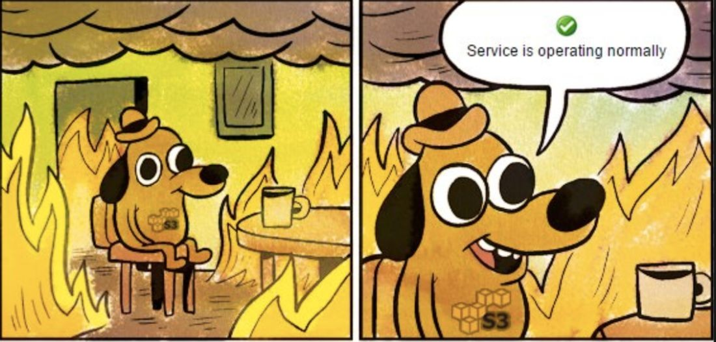

Slide 9
Intro to Cloud Computing: Agenda
Intro to Cloud Computing
Computing at scale
  The need for scalability; scale of current services
  Scaling up: From PCs to data centers
  Problems with 'classical' scaling techniques
Utility computing and cloud computing
  What are utility computing and cloud computing?
  What kinds of clouds exist today?
  What kinds of applications run on the cloud?
  Virtualization: How clouds work 'under the hood'
  Some cloud computing challenges

Slide 10
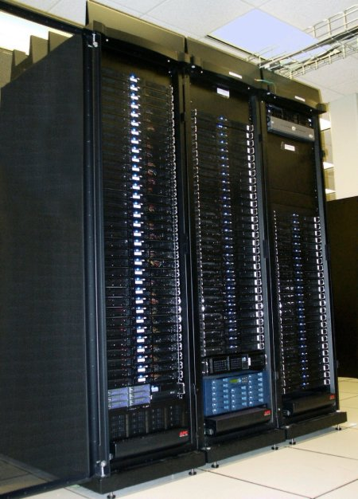
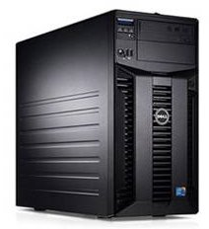
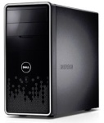
Scaling up
Computing Size
PC
Server
Cluster
What if one computer is not enough?
  Buy a bigger (server-class) computer
What if the biggest computer is not enough?
  Buy many computers

Slide 11
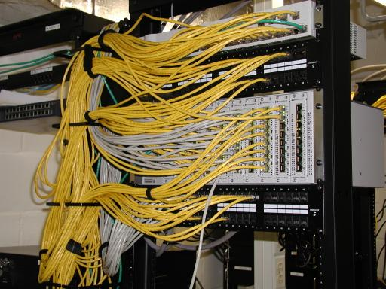
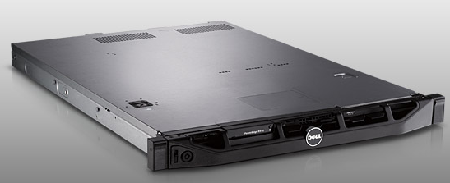
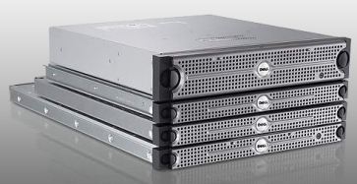
Characteristics of a cluster:
Network switch
(connects nodes with
each other and
with other racks)
Rack
Many nodes/blades
(often identical)
Storage device(s)
  Many similar machines, close interconnection (same room?)
  Often special, standardized hardware (racks, blades)
  Usually owned and used by a single organization

Slide 12
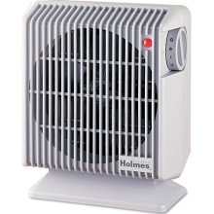
Power and cooling
Clusters need lots of power
  Example: 140 Watts per server
  Rack with 32 servers: 4.5kW (needs special power supply!)
  Most of this power is converted into heat
Large clusters need massive cooling
  4.5kW is about 3 space heaters
  And that's just one rack!

Slide 13
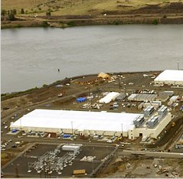
Scaling up
What if your cluster is too big (hot, power hungry) to fit into your office building?
PC
Server
Cluster
Data center
  Build a separate building for the cluster
  Building can have lots of cooling and power
  Result: Data center

Slide 14
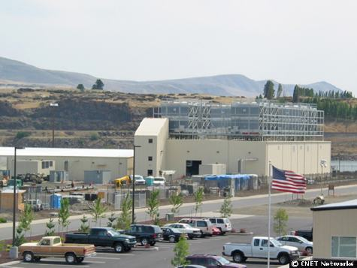
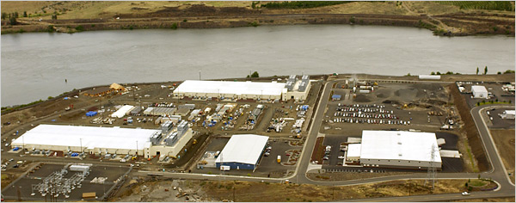
What does a data center look like?
A warehouse-sized computer
Cooling
plant
Data centers
(size of a
football field)
Google data center in The Dalles, Oregon
  A single data center can easily contain 10,000 racks with 100 cores in each rack (1,000,000 cores total)

Slide 15
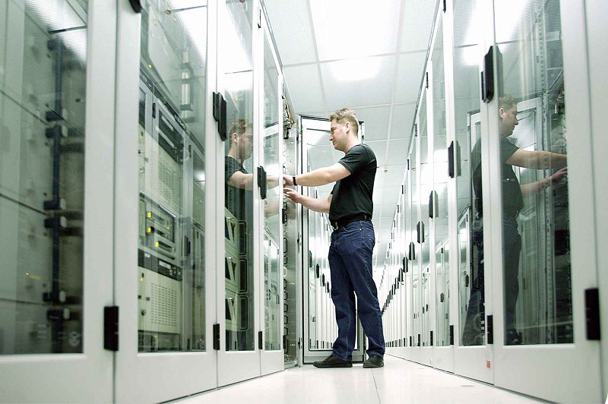
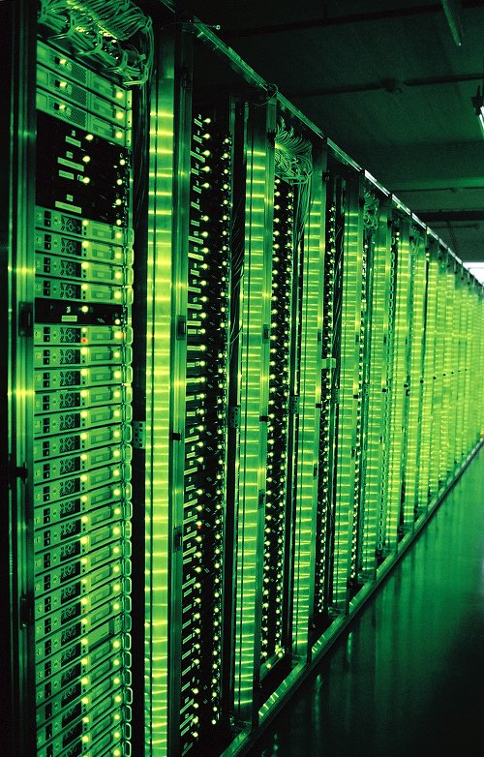
What's in a data center?
Hundreds or thousands of racks
Source: 1&1

Slide 16
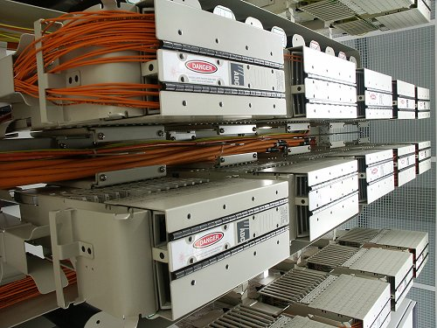
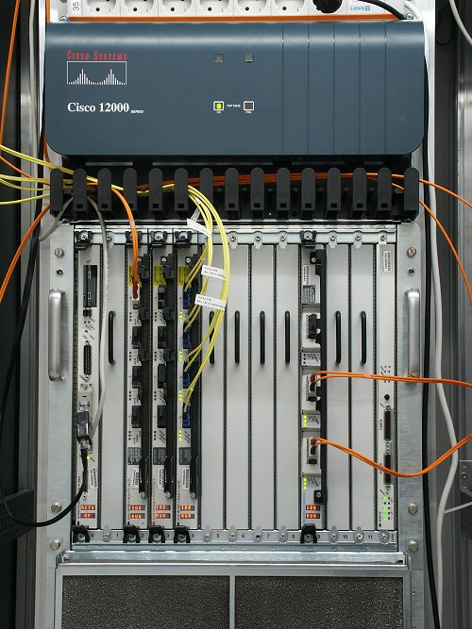
What's in a data center?
Massive networking
Source: 1&1

Slide 17
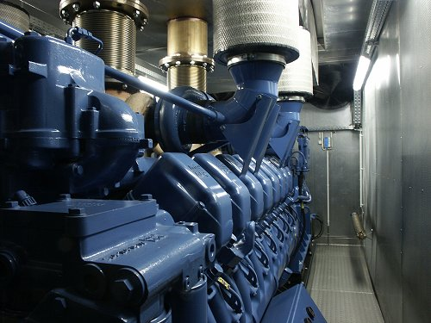
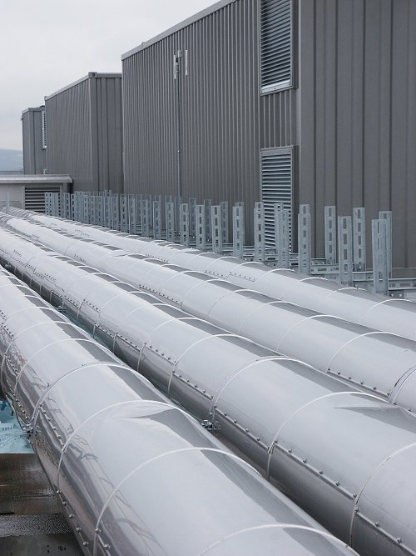
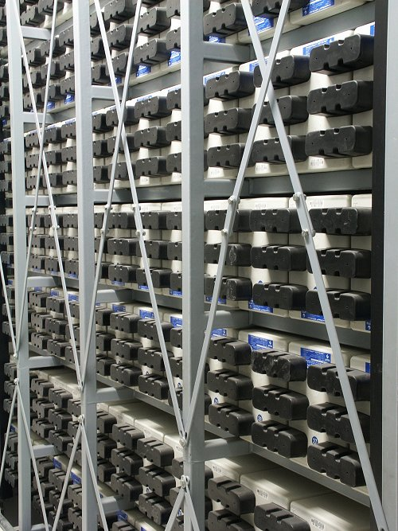
What's in a data center?
Emergency power supplies
Source: 1&1

Slide 18
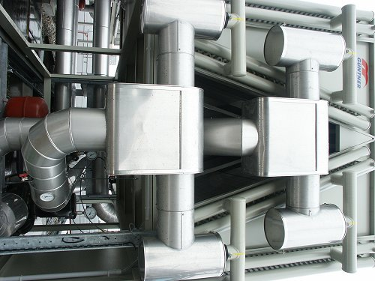
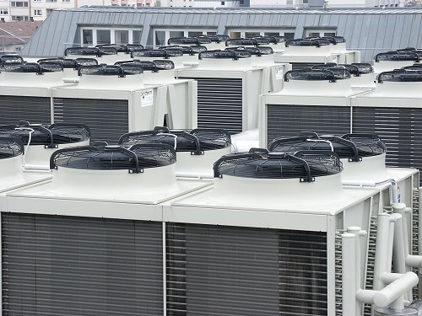
What's in a data center?
Massive cooling
Source: 1&1

Slide 19
Energy matters!
Data centers consume a lot of energy
Company | Servers | Electricity | Cost
eBay | 16K | ~0.6*10⁵ MWh | ~$3.7M/yr
Akamai | 40K | ~1.7*10⁵ MWh | ~$10M/yr
Rackspace | 50K | ~2*10⁵ MWh | ~$12M/yr
Microsoft | >200K | >6*10⁵ MWh | >$36M/yr
Google | >500K | >6.3*10⁵ MWh | >$38M/yr
USA (2006)
10.9M
610*10⁵ MWh
$4.5B/yr
Source: Qureshi et al., SIGCOMM 2009
  Makes sense to build them near sources of cheap electricity
  Example: Price per KWh is 3.6ct in Idaho (near hydroelectric power), 10ct in California (long distance transmission), 18ct in Hawaii (must ship fuel)
  Most of this is converted into heat → Cooling is a big issue!

Slide 20
Intro to Cloud Computing: Agenda
There are even bigger energy consumers:
  http://motherboard.vice.com/read/bitcoin-could-consume-as-much-electricity-as-denmark-by-2020
  2020 14 Gigawatts (Total power generation capacity of Denmark)
  1 Bitcoin in 2020 would consume half the annual household usage emitting 4,000 kg of CO₂
  This is a big issue because of the enthusiasm for the Blockchain driving new functionality

Slide 21
Scaling up
Intro to Cloud Computing: Agenda
PC
Server
Cluster
Data center
Network of data centers
What if even a data center is not big enough?
  Build additional data centers
  Where? How many?

Slide 22
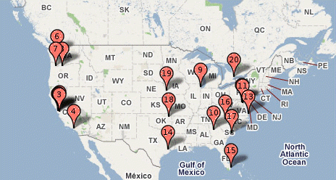
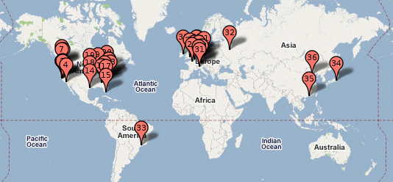
Global distribution
Intro to Cloud Computing: Agenda
Data centers are often globally distributed
  Example above: Google data center locations (inferred)
Why?
  Need to be close to users (physics!)
  Cheaper resources
  Protection against failures

Slide 23
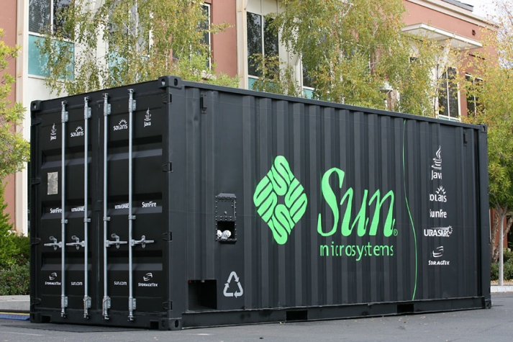
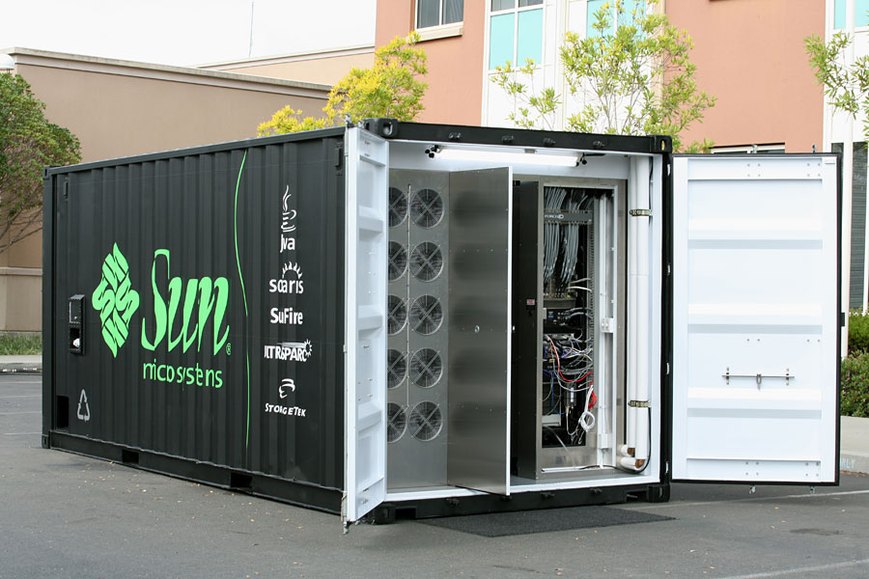
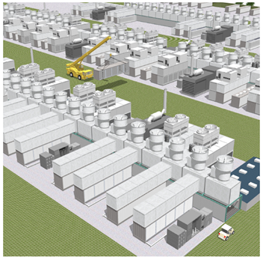
Trend: Modular data center
Intro to Cloud Computing: Agenda
Need more capacity? Just deploy another container!

Slide 24
Clouds Service models
“Private” Clouds
  Used for a company’s internal services only
  Example: Internal datacenters of companies like Facebook, Google, etc.
“Public” Clouds
  Anyone can purchase resources
  You can build your own company on top of another company’s cloud
  Example: AWS, GCP, Azure

Slide 25
Cloud Providers

Slide 26

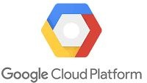
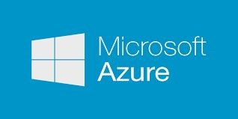
The Giants

